Slide 1
Vr 150 German Cultrue Fall 2021
Topic 2: The German Empire
Jie Hu 518370910057

Slide 2
Content
Introduction
Unification of Germany
Government system
Economic and politic development
The end of the empire

Slide 3


Introduction
Existed from 1871 to 1918
Motto: Gott mit uns
Anthem: Heil dir im Siegerkranz
Capital: Berlin
Emperor: Wilhelm I (1871-1888), Friedrich III (1888), Wilhelm II (1888-1918)
Flag
Coat of arms
https://en.wikipedia.org/wiki/German_Empire

Slide 4
Unification of Germany
German confederation
“The iron chancellor”
Dano-Prussian War
Austro-Prussian War
Franco-Prussian War

Slide 5
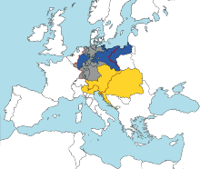
German Confederation
Consist of 39 German-speaking states
Created by the Congress of Vienna in 1815
The states could not reach an agreement, which made German Confederation weak
The German revolutions of 1848-1849 trying to unify the Confederation ended up with failure
Boundaries (in red) of the German Confederation with Prussia in blue, Austria in yellow, and the rest in grey
https://en.wikipedia.org/wiki/German_Confederation
Notes:
the conflict between the Kingdom of Prussia and the Austrian Empire was especially fierce

Slide 6
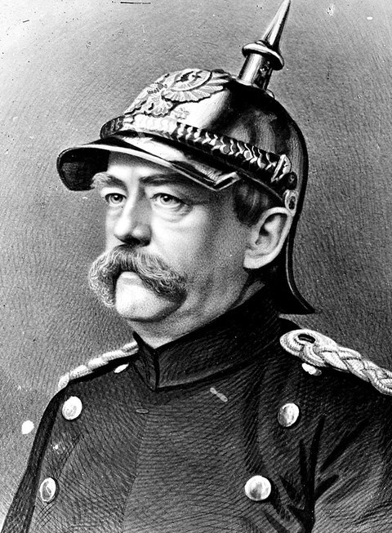
“The Iron Chancellor”
The chancellor of North German Confederation from 1867 to 1871, the chancellor or German Empire from 1871 to 1890
Supporter of the “Kleindeutsche Lösung”, i.e., founding a unified German without Austria (the “Großdeutsche Lösung” included Austria)
Delivered the “Iron and blood” speech
https://www.pensador.com/autor/otto_von_bismarck/
Notes:
On 30 September 1862, Bismarck made a famous speech to the Budget Committee of the Prussian Chamber of Deputies in which he expounded on the use of "iron and blood" to achieve Prussia's goals: Prussia must concentrate and maintain its power for the favorable moment which has already slipped by several times. Prussia's boundaries according to the Vienna treaties are not favorable to a healthy state life. The great questions of the time will not be resolved by speeches and majority decisions – that was the great mistake of 1848 and 1849 – but by iron and blood. [3]

Slide 7
Dano-Prussian War
Also known as the Second Schleswig War
Broke out in 1864
Focus on the conflict over the Schleswig-Holstein Question
The Kingdom of Prussia and the Austrian Empire formed an alliance against the Kingdom of Denmark
Ended up with the victory of the alliance, and Prussia and Austria took over the administration of Schleswig and Holstein.

Slide 8
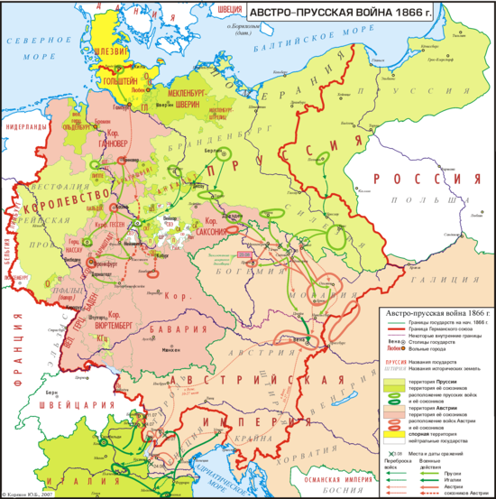
Austro-Prussian War
Broke out in 1866
Both Prussia and Austria led a number of German states, and Italy formed the alliance with Prussia
The Prussia-led alliance won the war, and the Prussia-led North German Confederation was founded
The Austrian (red) and Prussian (green) troops and their allies
https://en.wikipedia.org/wiki/Austro-Prussian_War
Notes:
The Kingdom of Prussia did not want to share the administration of Schleswig and Holstein with Austrian Empire
As a result, Schleswig and Holstein became province of Prussia, and all the German state except Austria and another four Southern states joined the North German Confederation

Slide 9
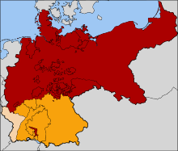
Franco-Prussian War
Broke out in 1870
Caused by Bismarck’s irritation
The four Southern German states aligned with the North German Confederation to fight against the French Empire, and finally joined the North German Confederation
Map of the North German Confederation (red), four Southern German States (orange) and Alsace-Lorraine (beige)
https://en.wikipedia.org/wiki/Franco-Prussian_War
Notes:
According to some historians, Prussian chancellor Otto von Bismarck deliberately provoked the French into declaring war on Prussia in order to draw four independent southern German states—Baden, Württemberg, Bavaria and Hesse-Darmstadt—to join the North German Confederation. As the unification of German was completed, the German states proclaimed their union as German Empire
[3]

Slide 10
Government system
Federal parliamentary semi-constitutional monarchy(1871-1916)
Federal parliamentary semi-constitutional monarchy under a military dictatorship(1916-1918)
The emperor had the absolute power to appoint or dismiss officials (including the chancellor)
The members of the federal parliament, which has the legislative power, were nominated by the kings of the German states
Every adult man (older than 25) had the right to vote in the Reichstag, but the power of the Reichstag was restricted by the federal parliament

Slide 11
Economic and politic development
Abandoned free trade and enacted heavy import tariff to benefit the development of industry in 1873
Enacted tariffs to protect German agriculture and industry in 1879
Established welfare state to benefit workers
Invested a lot in chemistry, motors and electricity, establishing the leading position in the world
Notes:
German workers enjoyed health, accident and maternity benefits, canteens, changing rooms, and a national pension scheme. German Empire became the largest economy in continental Europe in 1900

Slide 12
Economic and politic development
Founded alliance with Russia and Austria-Hungary in 1881
Signed a reinsurance pact with Russia in 1887, which was abolished in 1890
Established a commission to produce a common civil code in 1881, which came into effect in 1900
Expanded colonies in Asia and Pacific, leading to conflicts with the UK, Russia, Japan and the US
Notes:
The “Dreikaiserbund”. But the Russia Empire rejected German’s attack towards France. The relationship between Russia and France became stronger after the abolishment

Slide 13
The end of the empire
German Empire in World War I
The November revolution

Slide 14
German Empire in World War I
In the Western Front, German Empire desired a quick victory, which ended up with failure. In 1916, the Battle of Verdun broke out, and both sides suffered great loss. The war came to a stalemate.
In the Eastern Front, German Empire achieved success. The Russian army was beaten by the German army in the battle of Tannenberg. In 1917, revolution broke out in the Russian Empire, and Russia had to quit the war in 1918.

Slide 15
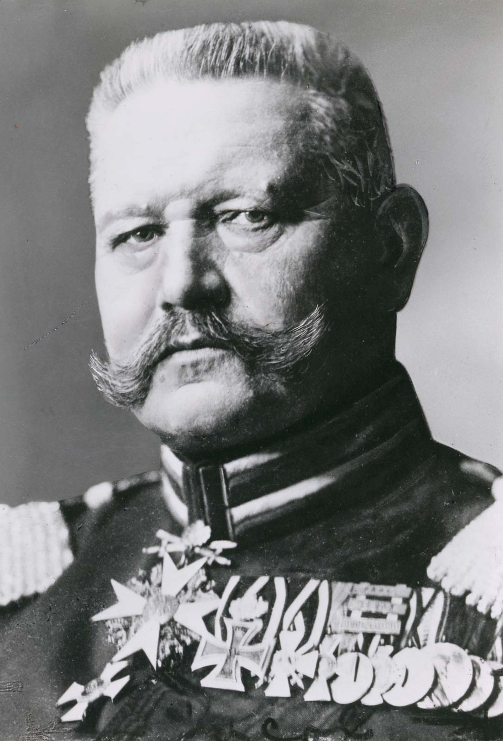
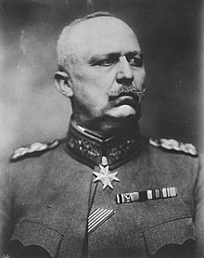
German Empire in World War I
Hindenburg and Ludendorff were commanders of the Eastern front. Their success earned them great prestige. They became the real ruler of the German Empire by the end of the war.
PauI von Hindenburg
Erich Ludendorff
https://commons.wikimedia.org/wiki/File:Paul_von_Hindenburg-2.png
https://de.wikipedia.org/wiki/Erich_Ludendorff
Notes:
Hindenburg became the president of Weimar Republic, and Ludendorff’s behavior led to the Rise of Nazi

Slide 16
The November revolution
In the spring of 1918, German Empire launched several attacks, but all of the attacks ended up in failure. Many German soldiers desired an end to the war.
In late October 1918, in Kiel, soldiers of the German Navy refused to carry out the order to attack. The revolt spread to many cites soon, and the workers and soldiers seized the power. The emperor had to flee. On 9 November 1918, SPD proclaimed the foundation of a new government, and German Empire came to the end.

Slide 17
Quiz
In which year was German Empire founded?
In which year did Bismarck resigned?
Which country was the ally of Prussia in Austro-Prussian war? (except the German states)

Slide 18
Quiz
Who could vote in the Reichstag?
Who was the emperor of German Empire in 1900?
Which party found a new government in 1918?

Slide 19
Q&A
Thanks!
Feel free to ask if you have any questions.

Slide 20
References
[1] https://en.wikipedia.org/wiki/German Empire
[2] https://en.wikipedia.org/wiki/German_Confederation
[3] https://en.wikipedia.org/wiki/Otto_von_Bismarck
[4] https://en.wikipedia.org/wiki/Second_Schleswig_War
[5] https://en.wikipedia.org/wiki/Franco-Prussian_War
[6] https://commons.wikimedia.org/wiki/File:Paul_von_Hindenburg-2.png
[7] https://de.wikipedia.org/wiki/Erich_Ludendorff

